Slide 1
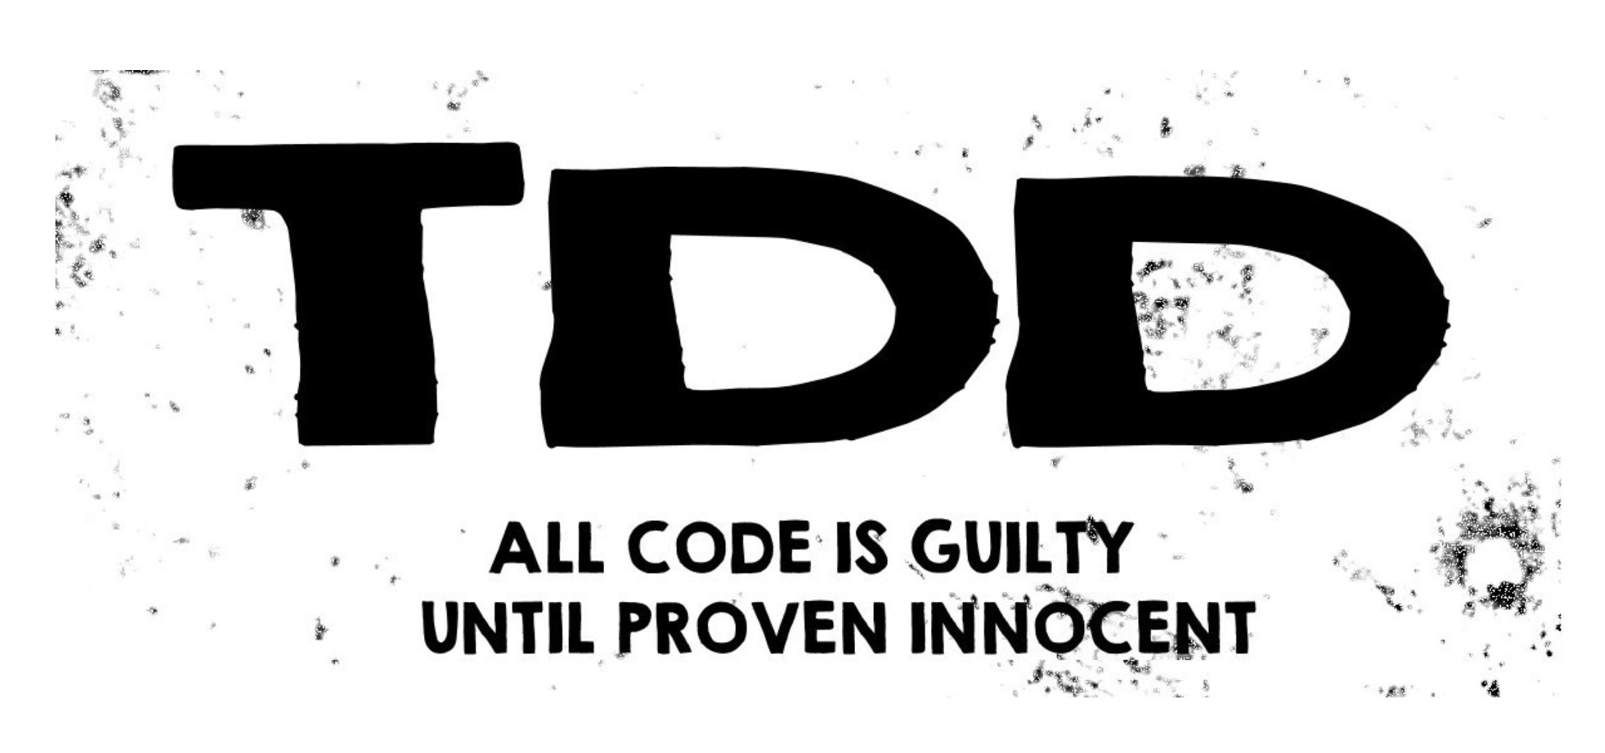
Test Driven Development: what it is, and what it is not.
Notes:
Test-driven development (TDD) is a technique for developing and designing software where tests are created before production code in short cycles. A common mistake is to believe that just by creating tests before production code will make the application design “just happens.” As with any other technique, TDD is not a silver bullet, and while it certainly helps to achieve some desirable characteristics in software, such as decoupling and separation of concerns, other practices should complement its usage, especially for architecture and design coherence.
<number>

Slide 2
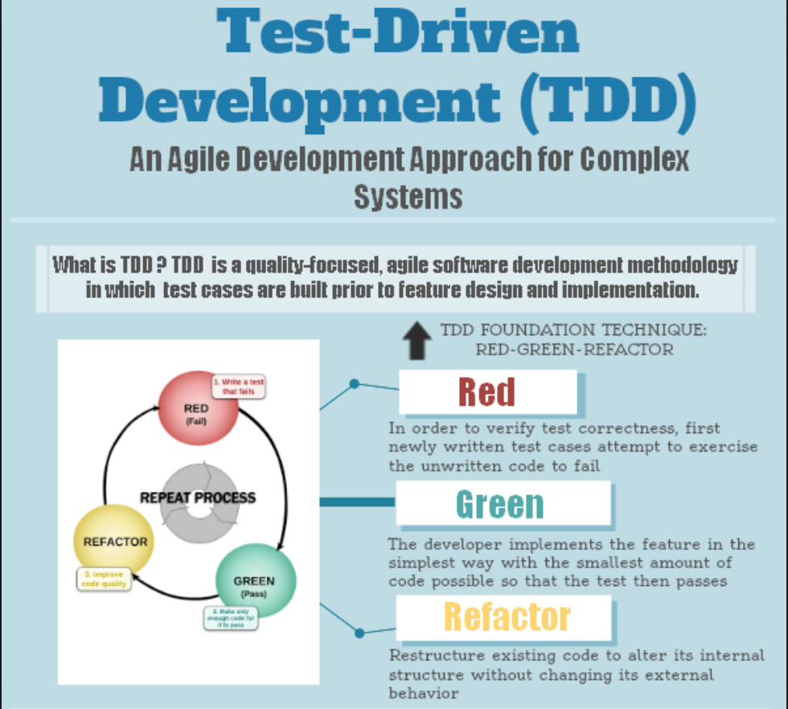

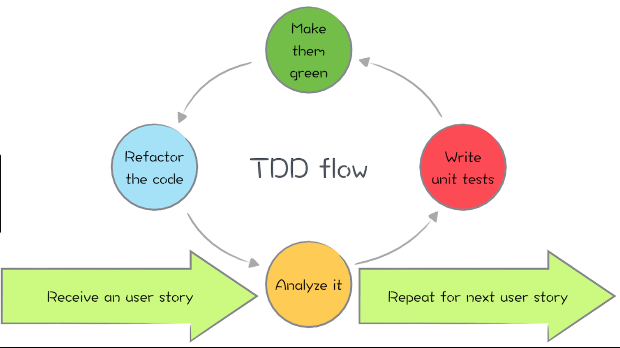
Notes:
Test-driven development (TDD) has become popular among developers as it is one of the most important practices in any agile method, such as Extreme Programming (Beck, 2004). The practice suggests developers write a unit test before the production code in short cycles (Beck, 2002; Astels, 2003). In practice, a developer first introduces a new failing test, and then writes the smallest piece of code possible in the production code in order to make the test suite execute successfully. As a final step, the code is refactored, if necessary, to provide a better structure to the current solution.There is some discussion in the software engineering community about whether TDD can be used to achieve software quality. Although the practice contains the word “test” on its name, a common speech among practitioners is that TDD drives developers toward a better code and class design. The idea is reinforced by many well-known book authors, such as Kent Beck (2002), Robert Martin (2002), e Nat Pryce (2009), and Dave Astels (2003).
<number>

Slide 3
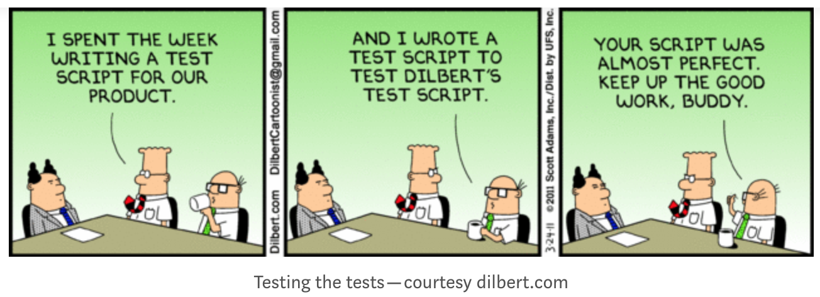
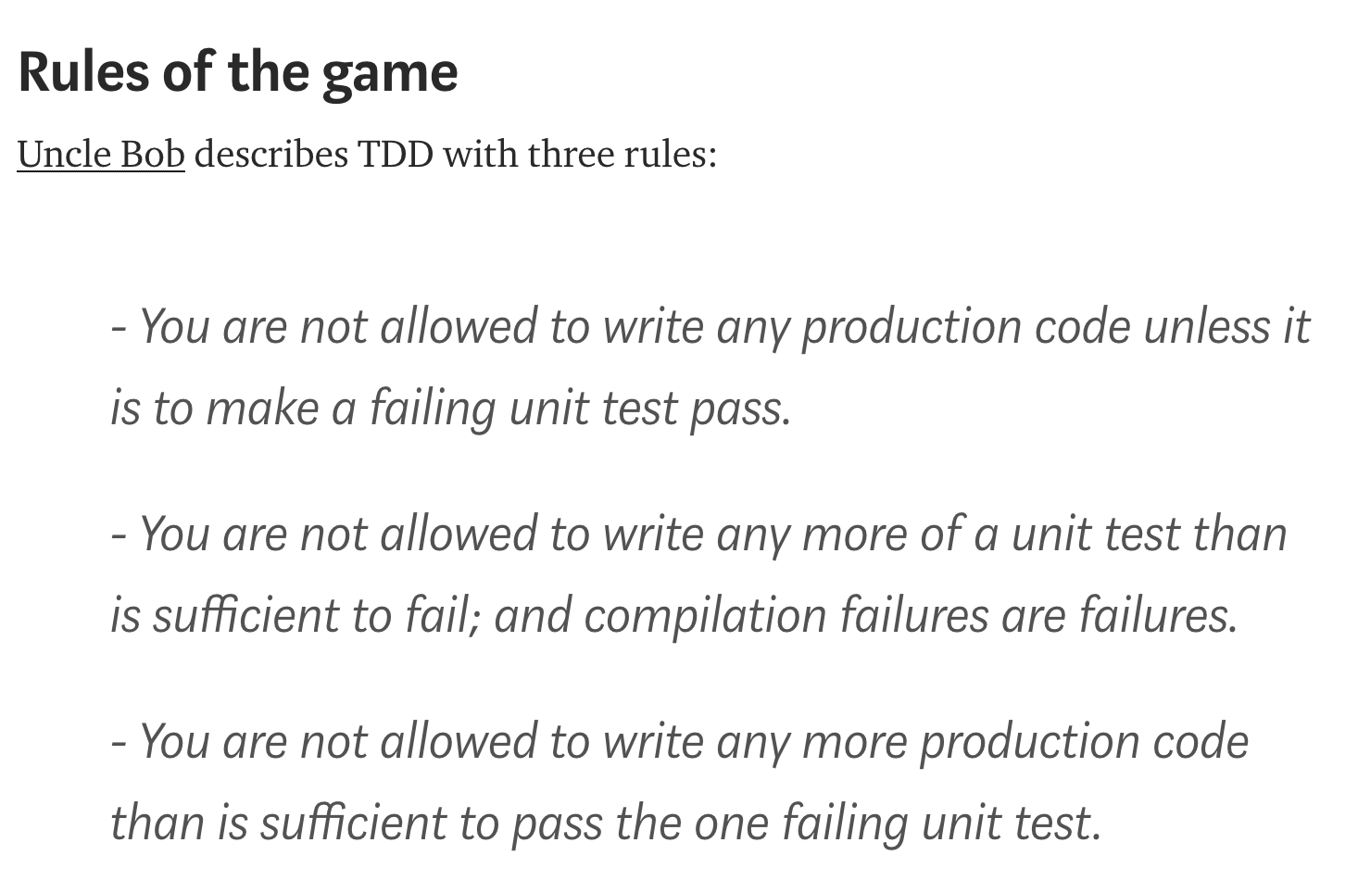
Notes:
<number>

Slide 4
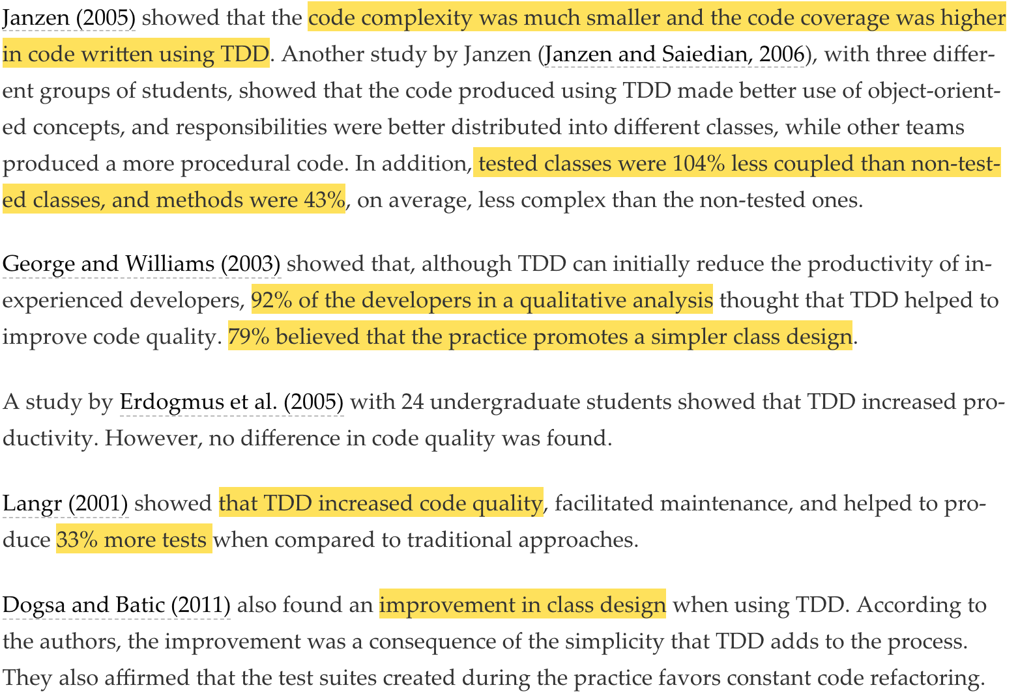
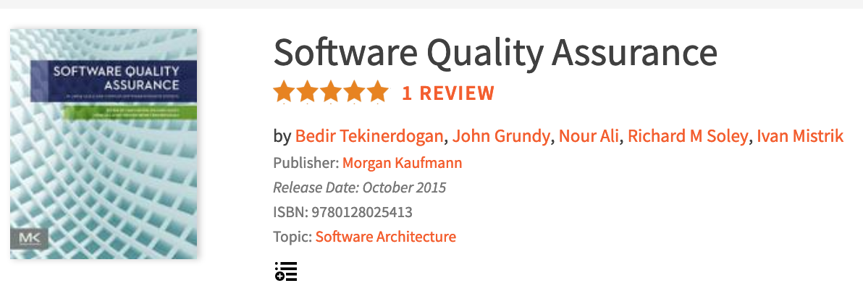
Evidences on the Influence of TDD on Software Quality
Notes:
<number>
Evidences on the Influence of TDD on Software Quality

Slide 5
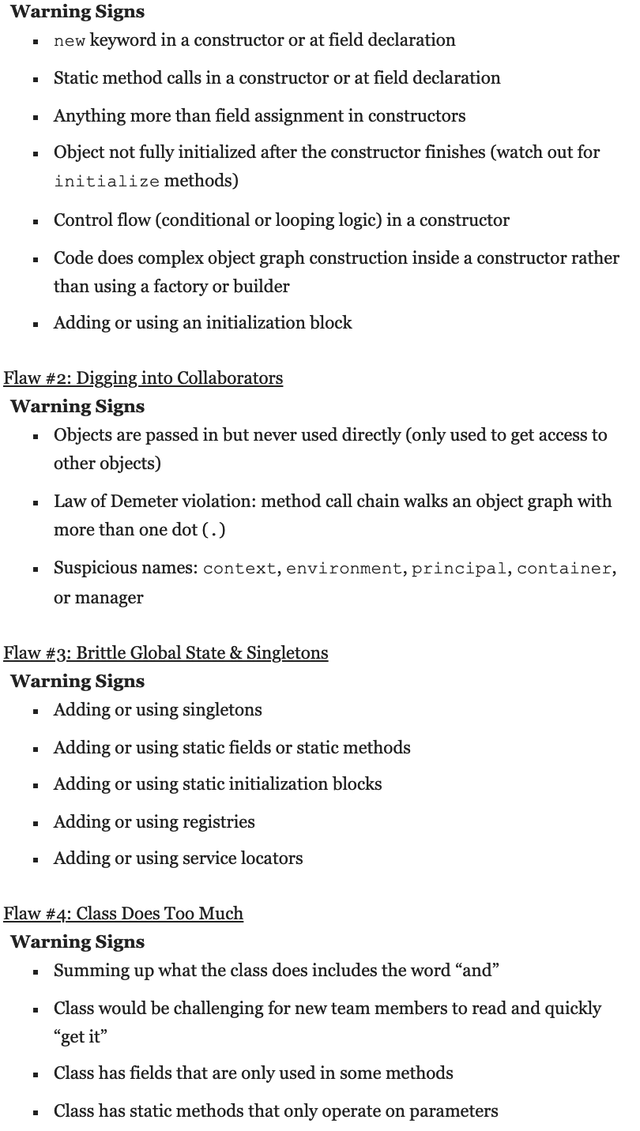
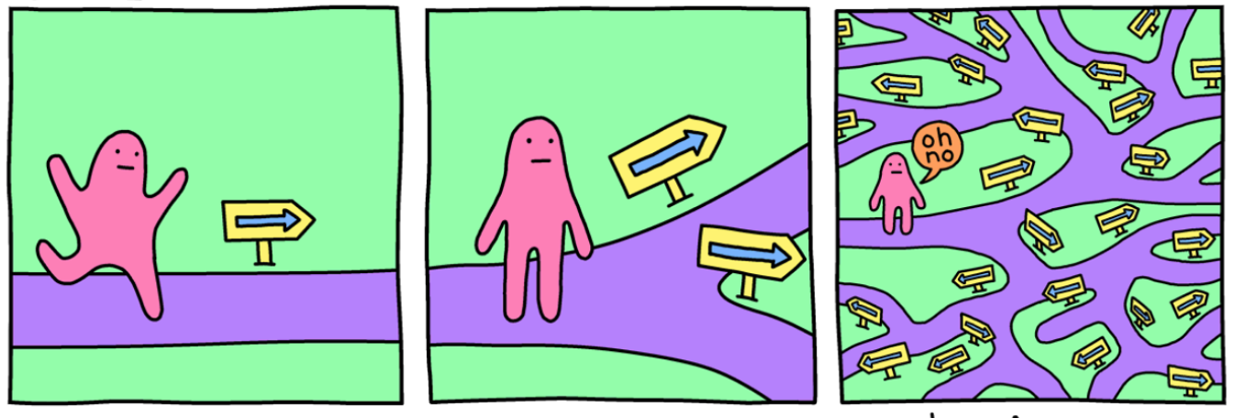
Writing testable code? How to?
http://misko.hevery.com/code-reviewers-guide/ - @Google Inc.
Notes:
<number>
Evidences on the Influence of TDD on Software Quality

Slide 6
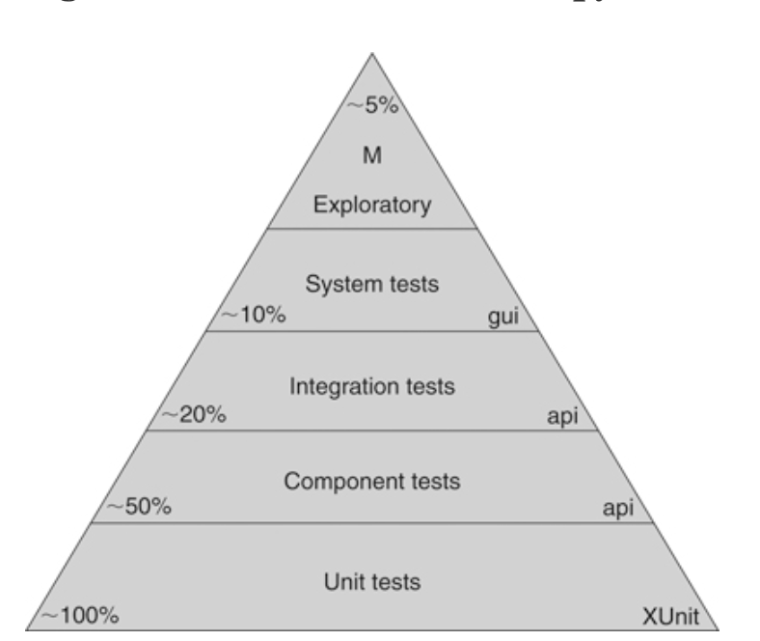
THE TEST AUTOMATION PYRAMID - The Clean Coder by Uncle Bob – Robert C Martin
Type | Who? | CI(yes/no) | Description | Coverage(%)
Unit Tests | Programmer | Yes | Low level specification | ~ 80%-90%
Component Tests | QA/Business/ Dev | Yes | Acceptance tests (individual component) | ~ 50%
Integration Test | System architects / Lead Developers | No | They are plumbing tests(they do not test business rules) | ~ 20%
System Tests | System architects/ Lead Developers | No | Automated E2E tests | ~ 10%
Manual Test | Dev/QA/BA/Project | No |  | ~ 5 %
Notes:
<number>
Evidences on the Influence of TDD on Software Quality

Slide 7
Implementing using Toolchain(Maven, Gradle, etc)
slow
E2E
$$$
Fitness/cucumber/standalone
Integration
Cucumber-jvm
execution
cost
Failsafe – should run second
Given-When-Then
Part of the CI
Unit
Small Isolated
fast
Surefire – should run first
Arrange-Act-Assert
$
Maven Plugin | Default naming convention | Style
Surefire | "**/Test*.java, "**/*Test.java”"**/*Tests.java, "**/*TestCase.java” | TDD
Failsafe | “IT*.java”, “*IT.java”, “ITCase.java” | TDD
Cucumber-jvm | *.feature | BDD
Notes:
<number>
Evidences on the Influence of TDD on Software Quality

Slide 8
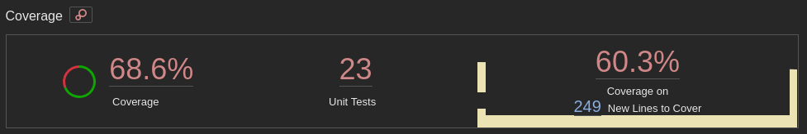
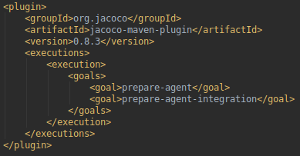
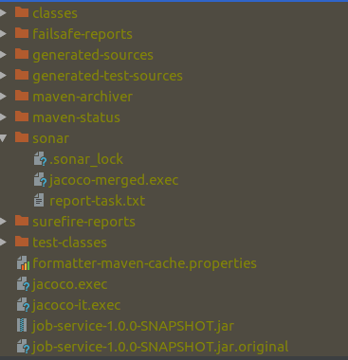
Using SonarJava to capture Coverage for java based projects
https://docs.sonarqube.org/display/PLUG/SonarJava
https://www.eclemma.org/jacoco/trunk/doc/check-mojo.html
SonarQube
Jacoco
Jacoco/Cobertura
Failsafe
Surefire
Maven Plugin | Folder | Files
Sonar | sonar | jacoco-merged.exec
Jacoco |  | Jacoco.exec/jacoco-it.exec
Surefire/Failsafe | surefire-reports, failsafe-reports
Notes:
<number>
Evidences on the Influence of TDD on Software Quality

Slide 9
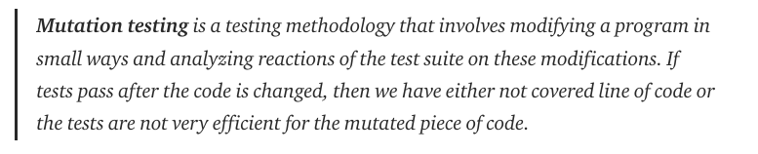
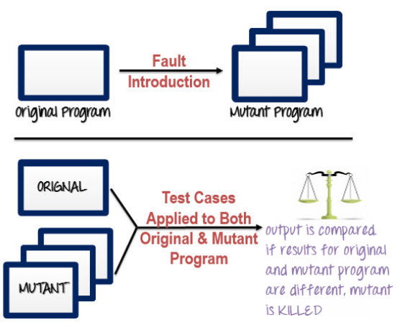
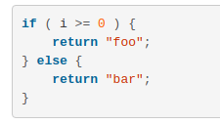
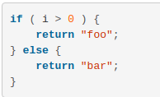
How well do I write my test cases? Mutation to the rescue …
Adding
Faults(as
Mutates)

Slide 10
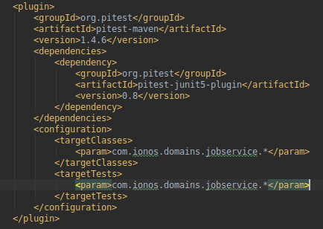
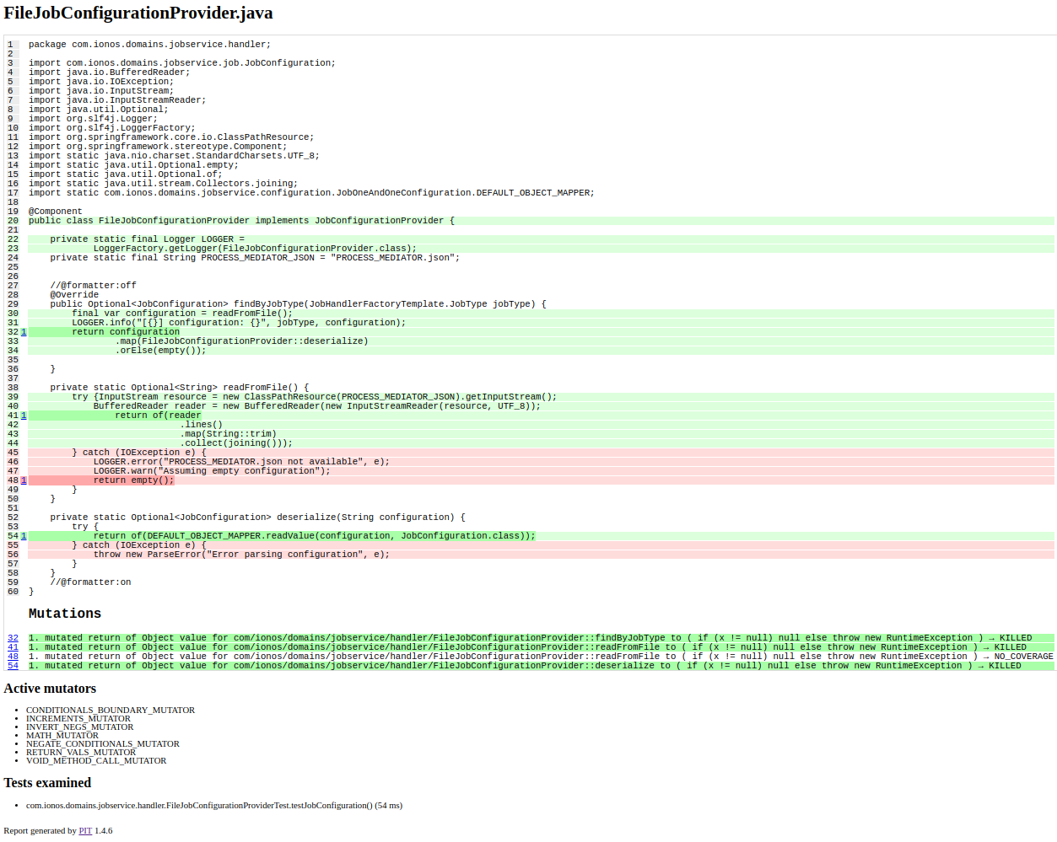
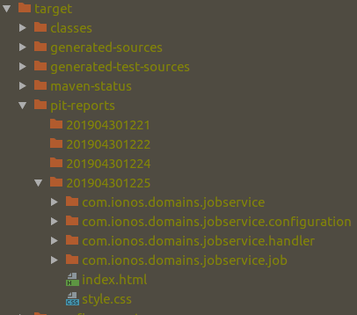
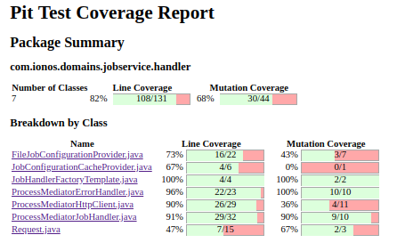
Mutation using Apache PIT
http://pitest.org/quickstart/maven/
mvn test org.pitest:pitest-maven:mutationCoverage -DtimeoutConstant=8000

